Slide 1


Green Pace
Security Policy Presentation
Developer: Benjamin Sturgeon

Slide 2

OVERVIEW: DEFENSE IN DEPTH
This Security Policy establishes a set of standards along with best practices so that the security of Green Pace’s software and storage mediums. Each of these are established following the design of Defense in Depth.

Slide 3
THREATS MATRIX
Unlikely:
Unlikely to lead to an exploitable vulnerability
Low Priority: Low severity, unlikely, expensive to repair
Likely:
Likely to lead to a Exploitable Vulnerability
Priority:
High severity, likely, inexpensive to repair
Likely STD-002-CPP STD-007-CPP | Priority STD-004-CPP STD-005-CPP STD-009-CPP
Low priority STD-001-CPP STD-006-CPP STD-008-CPP | Unlikely STD-003-CPP STD-006-CPP STD-010-CPP

Slide 4
10 PRINCIPLES
Validate Input Data: STD-004-CPP, STD-009-CPP
2 Heed Compiler Warnings: STD-001-CPP, STD-002-CPP, STD-009-CPP, STD-010-CPP
3 Architect and Design for Security Policies: STD-006-CPP, STD-007-CPP, STD-008-CPP, STD-010-CPP
4 Keep It Simple: STD-002-CPP, STD-004-CPP, STD-008-CPP
5 Default Deny:
6 Adhere to the Principle of Least Privilege:
7 Sanitize Data Sent to Other Systems: STD-009-CPP
8 Practice Defense in Depth: STD-005-CPP
9 Use Effective Quality Assurance Techniques: STD-003-CPP, STD-005-CPP, STD-007-CPP
10 Adopt a Secure Coding Standard: STD-003-CPP, STD-008-CPP

Slide 5
CODING STANDARDS
Coding Standards Have been Placed in order by Priority
STD-004-CPP Sanitize data passed to complex subsystems
STD-005-CPP Properly deallocate dynamically allocated resources
STD-003-CPP Range check element access
STD-008-CPP Do not modify the standard namespaces
STD-002-CPP Value-returning functions must return a value from all exit paths
STD-007-CPP Handle all exceptions
STD-001-CPP Never qualify a reference type with const or volatile
STD-006-CPP Understand the termination behavior of assert() and abort()
STD-009-CPP Guarantee that library functions do not overflow
STD-010-CPP Write constructor member initializers in the canonical order

Slide 6
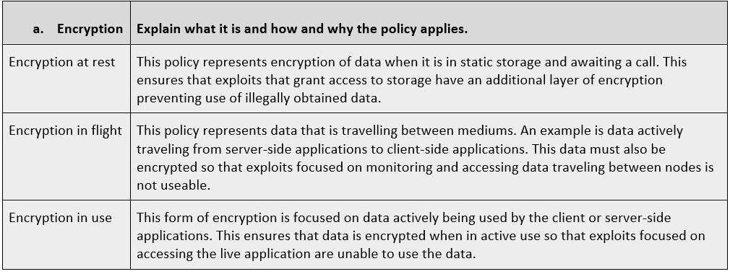
ENCRYPTION POLICIES

Slide 7
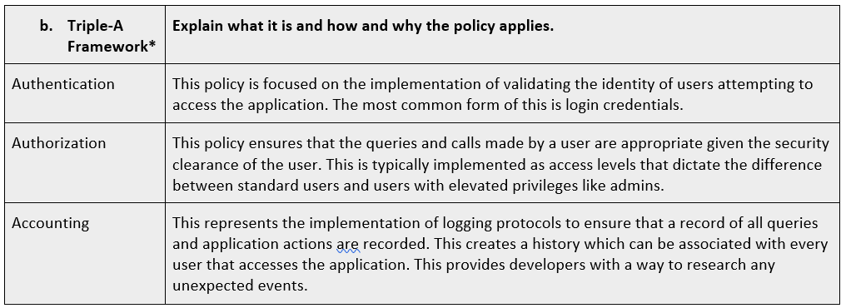
TRIPLE-A POLICIES

Slide 8
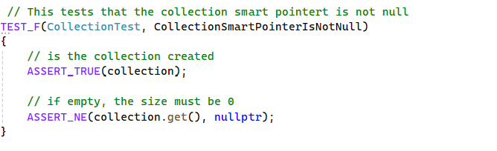
Unit Testing
Test that collection smart pointer is not null:

Slide 9
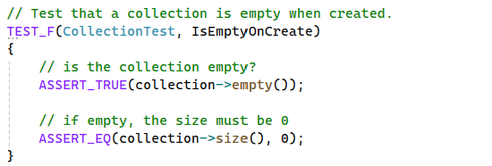
Unit Testing
Test that collection is empty when created:

Slide 10
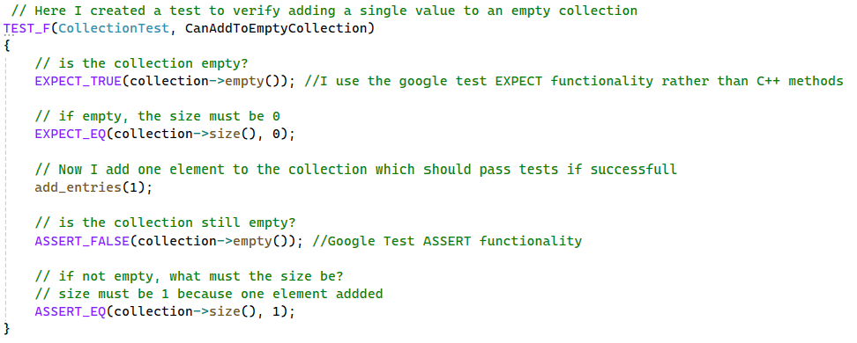
Unit Testing
Test adding a single value to empty collection:

Slide 11
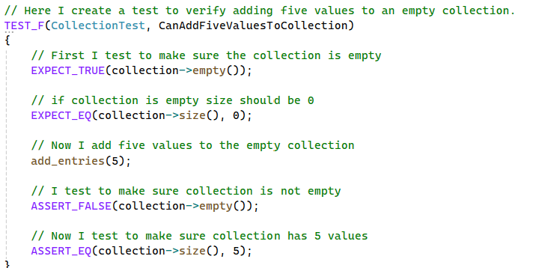
Unit Testing
Test adding five values to an empty collection:

Slide 12
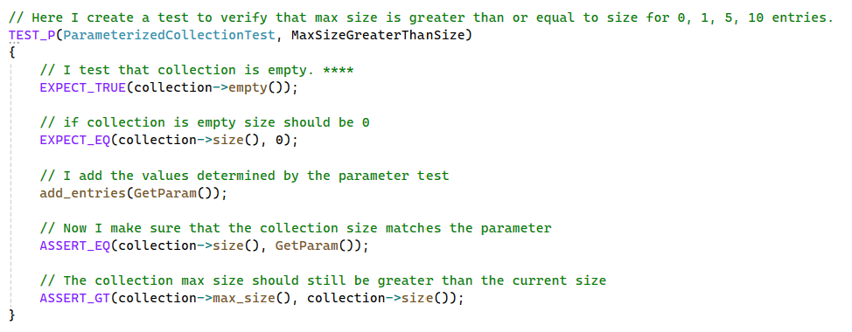
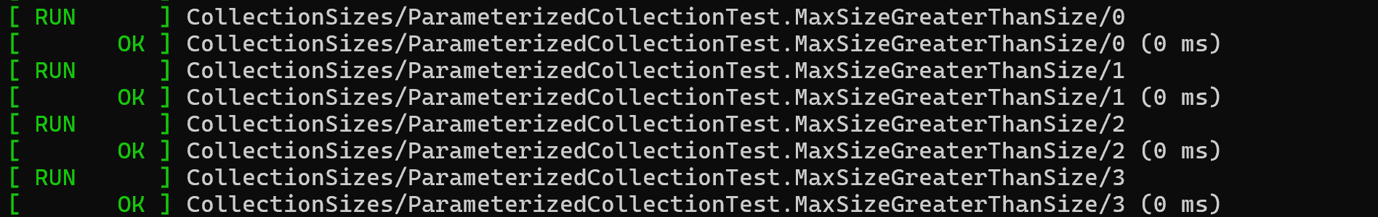
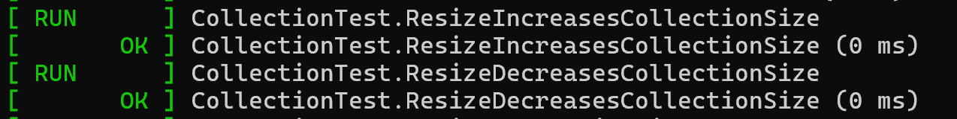
Unit Testing
Test that max size is greater than or equal to size for 0,1,5,10 entries:

Slide 13
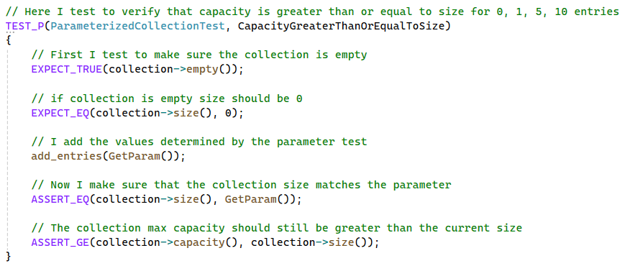
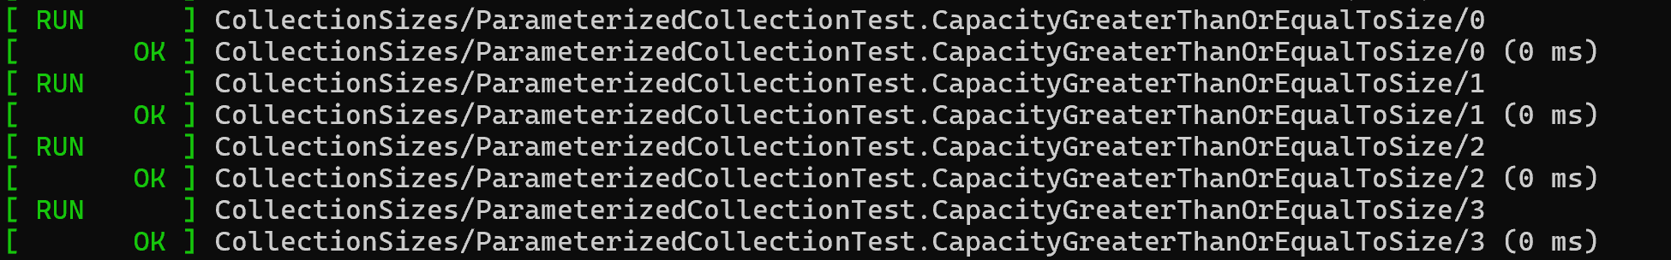
Unit Testing
Test to verify that capacity is greater than or equal to size for 0, 1, 5, 10 entries:

Slide 14
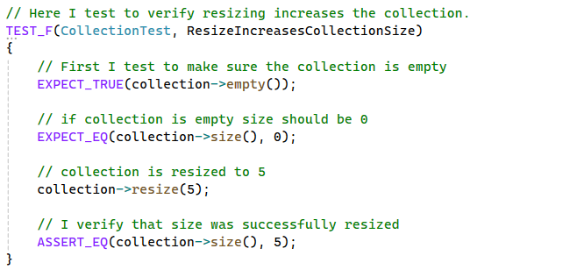
Unit Testing
Test to verify resizing increases collection:

Slide 15
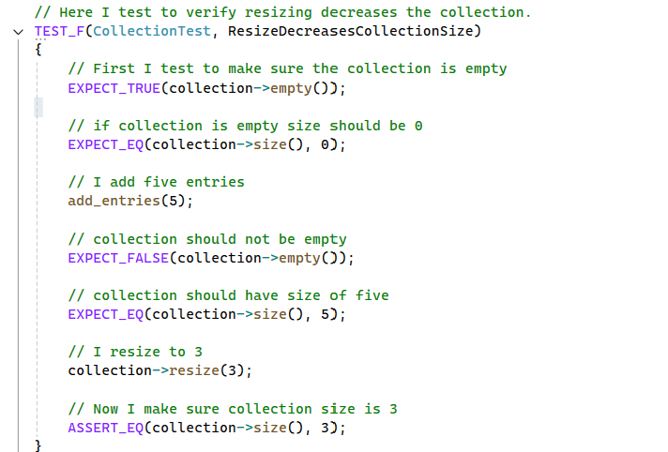
Unit Testing
Test to verify resizing decreases collection:

Slide 16
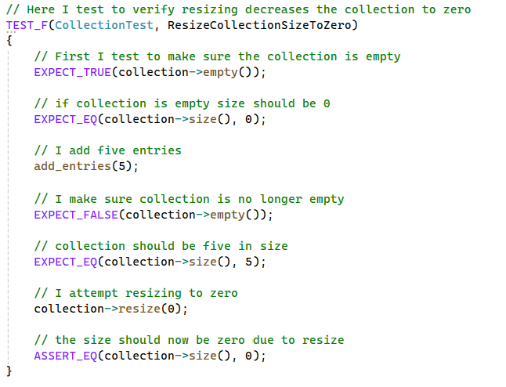
Unit Testing
Test to verify resizing decreases collection to zero:

Slide 17
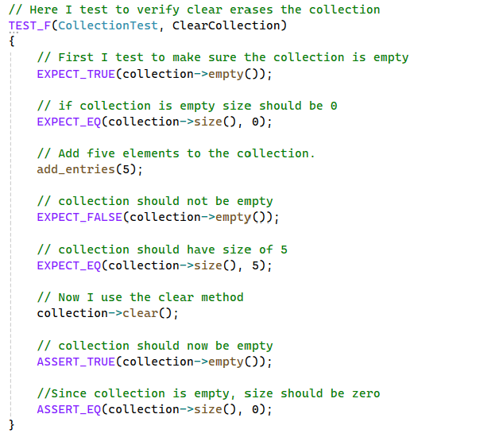
Unit Testing
Test to verify clear collection:

Slide 18
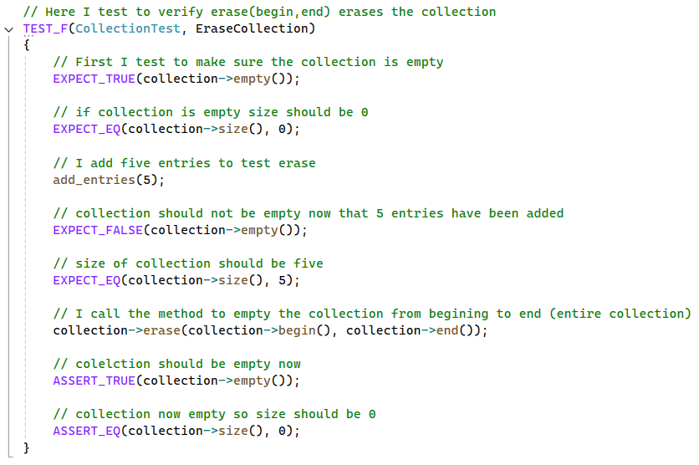
Unit Testing
Test to verify erase collection:

Slide 19
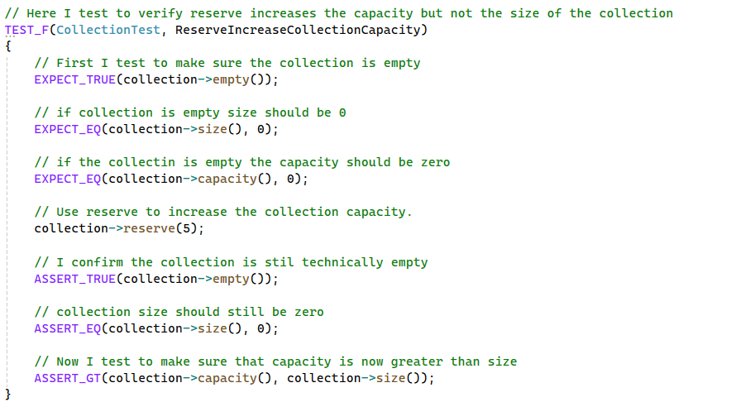
Unit Testing
Test to verify reserve increases capacity but not size:

Slide 20
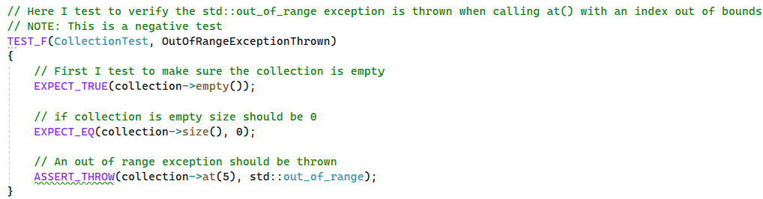
Unit Testing
Test to verify out of range index:

Slide 21
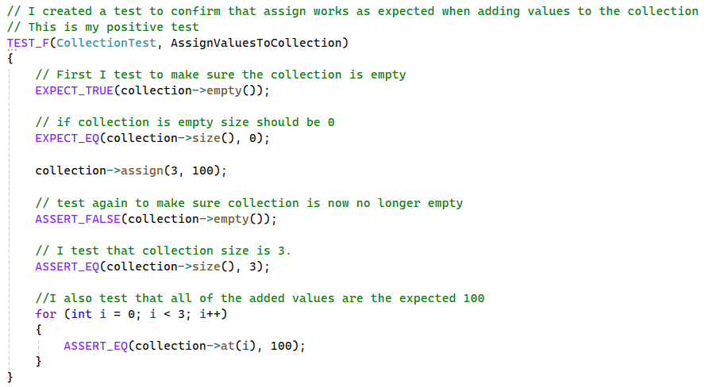
Unit Testing
Test to verify assign works as expected when adding values

Slide 22
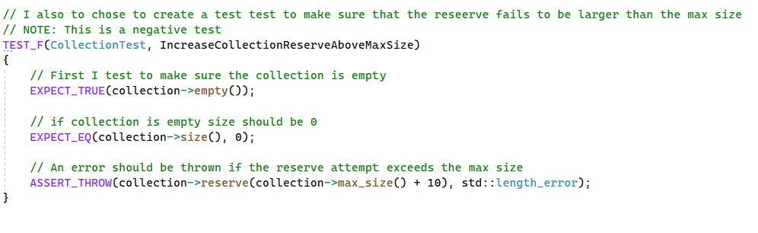
Unit Testing
Test to verify reserve increases capacity but not size:

Slide 23

AUTOMATION SUMMARY
Implementation of DevSecOps practices and automation empowers creation of exceptionally secure applications by addressing security concerns throughout the SDLC.
This summary provides a visual depiction of the stages of development and the power of automation in the middle.

Slide 24
TOOLS
The DevSecOps pipeline outlines the progression of the development process:
Pre-production: Includes activities for designing and testing the software.
Production: Covers tasks for deploying, monitoring, and maintaining the software. Stages within the pipeline include:
Design stage: Utilizes OWASP or Security Policy frameworks to ensure a secure design.
Build stage: Incorporates IDEs and compilers for code compilation and execution.
Verify and Test stage: Employs static analysis tools and unit testing methods.
Monitor and Detect stage: Uses logging mechanisms and application monitoring tools.

Slide 25
RISKS AND BENEFITS
Should security be implemented now or deferred to a later stage?
The answer is IMMEDIATELY!
Ensuring the security of your application and data is a critical responsibility that demands immediate attention.
Security should be considered as early as the planning phase.
Benefits of early implementation:
Facilitates seamless integration when security is planned from the beginning.
Results in more robust and reliable code.
Promotes greater consistency in the codebase.
Risks of delaying security:
Lack of buy-in from stakeholders may hinder implementation.
Retrofitting security measures later can be challenging and less effective.
Delayed action increases vulnerability to breaches and exposure of sensitive data.

Slide 26
RECOMMENDATIONS
A security policy is ineffective unless it is properly understood and consistently adhered to.
Key measures to strengthen security include:
DevSecOps training: Equip developers with the knowledge and skills to implement secure practices.
Automated monitoring: Regularly assess software dependencies for vulnerabilities and apply patches to mitigate supply chain attack risks.
Google's Security Best Practices : Explore comprehensive guidance to enhance dependency management and software security.

Slide 27
CONCLUSIONS
Security should be a priority from the very beginning of the development process.
Comprehensive training on security practices and the security policy must be provided to all relevant stakeholders.
Enforcement mechanisms are essential to ensure strict adherence to the security policy.
Application deployment must be restricted until all security policy requirements are fully satisfied.
The security policy should undergo regular reviews and updates to address emerging risks and evolving needs.

Slide 28
REFERENCES
Google. (2025a). Security best practices | workflows | google cloud. Google. https://cloud.google.com/workflows/docs/security-best-practices
Sei cert C++ coding standard. SEI CERT C++ Coding Standard - SEI CERT C++ Coding Standard - Confluence. (2024, February 14). https://wiki.sei.cmu.edu/confluence/pages/viewpage.action?pageId=88046682

